Slide 1
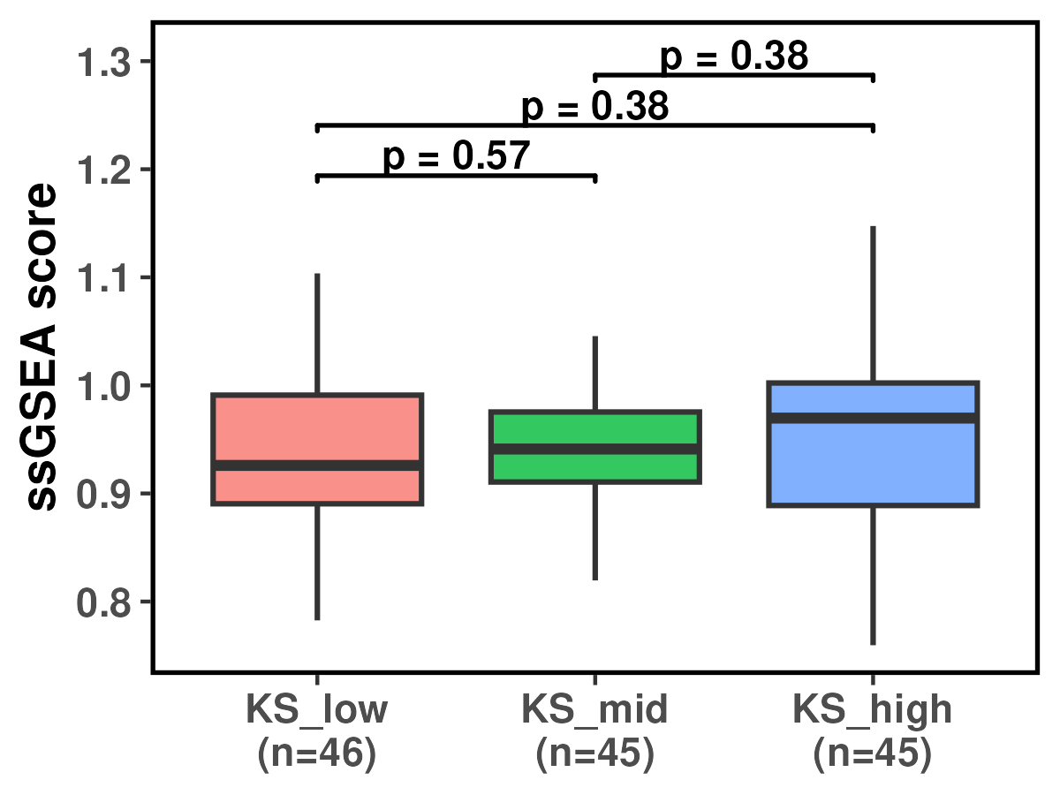
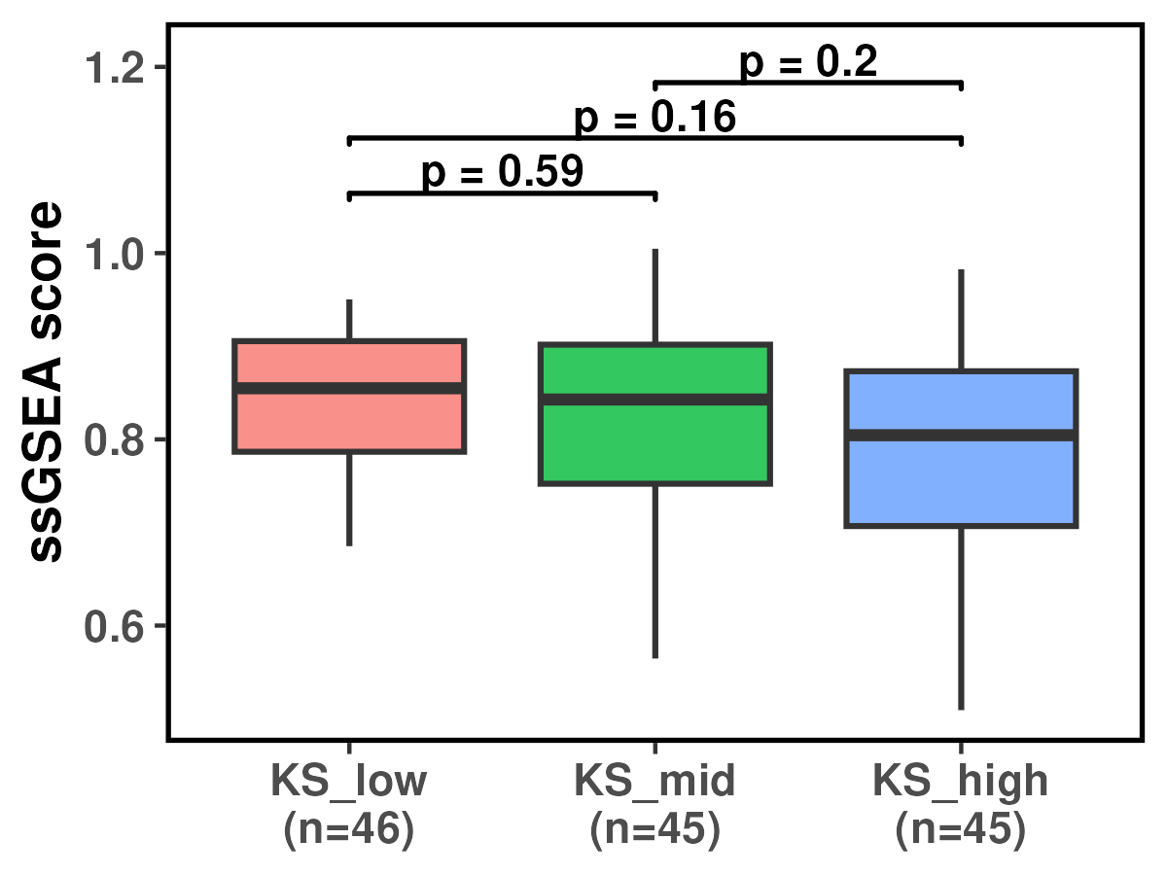
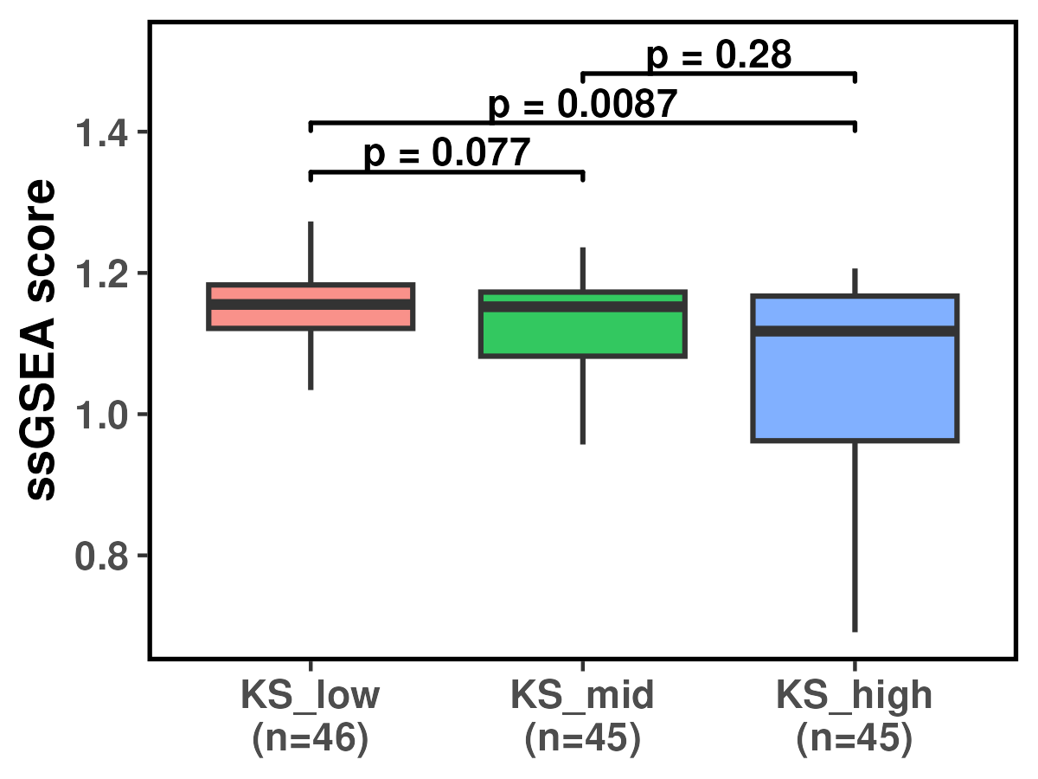
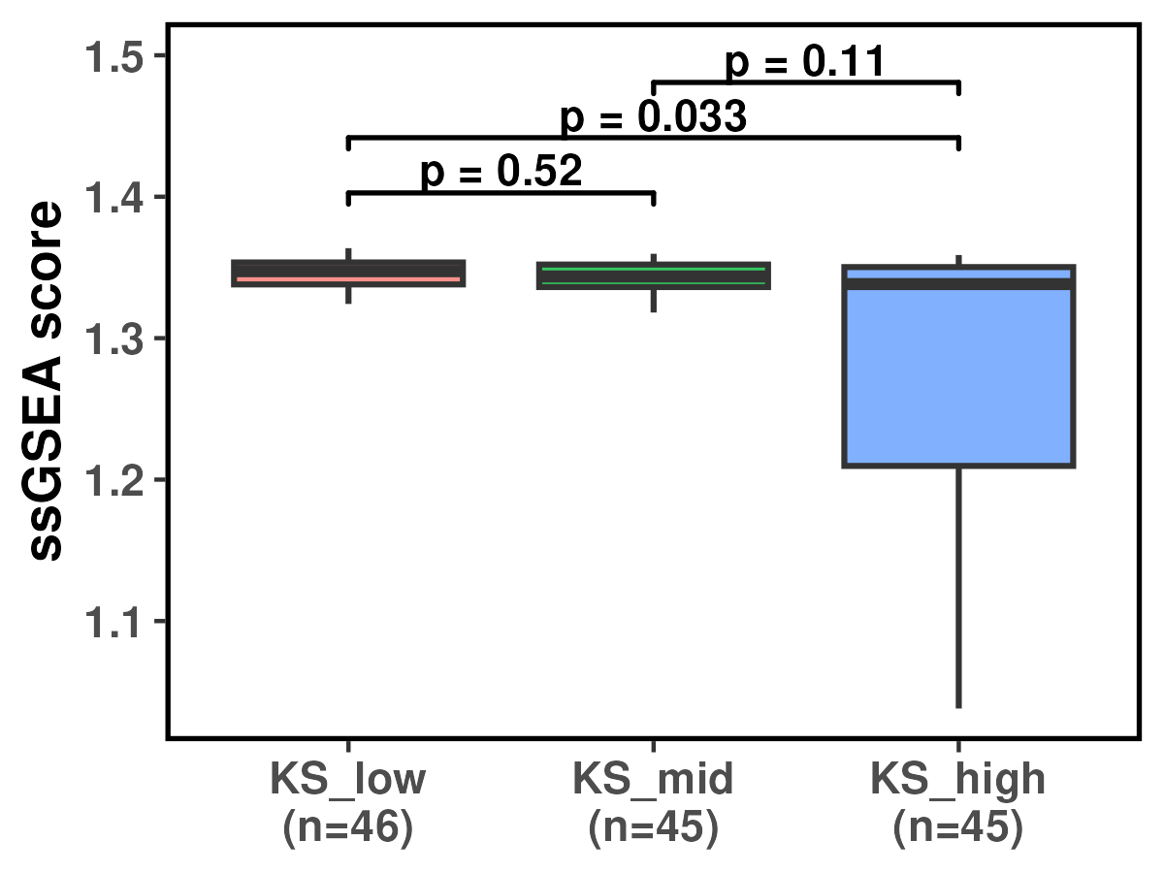
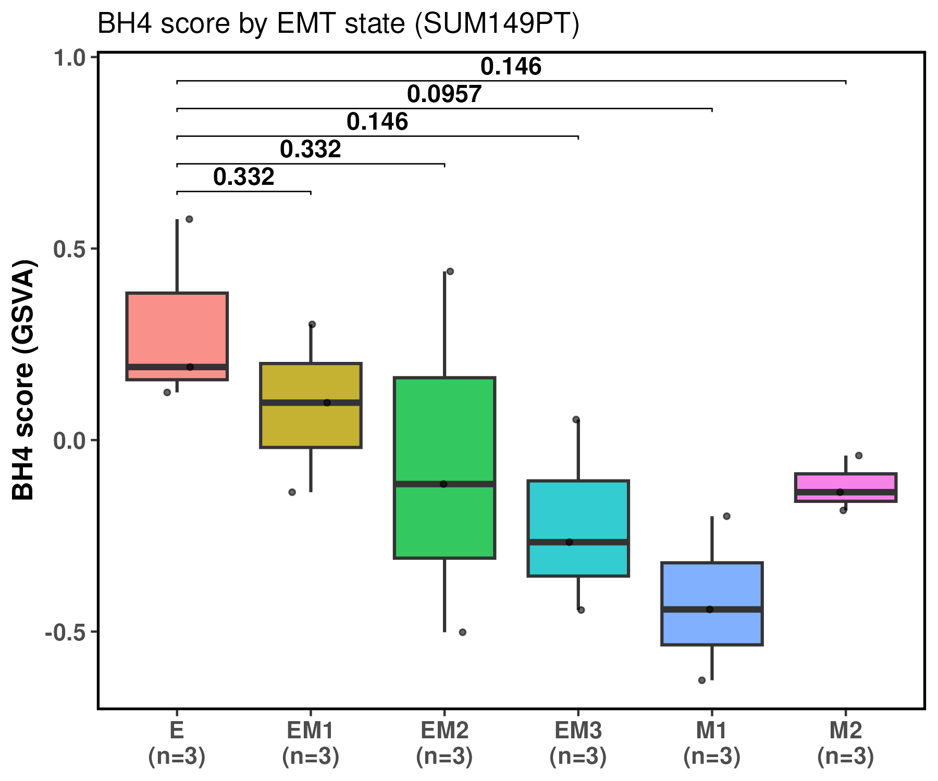
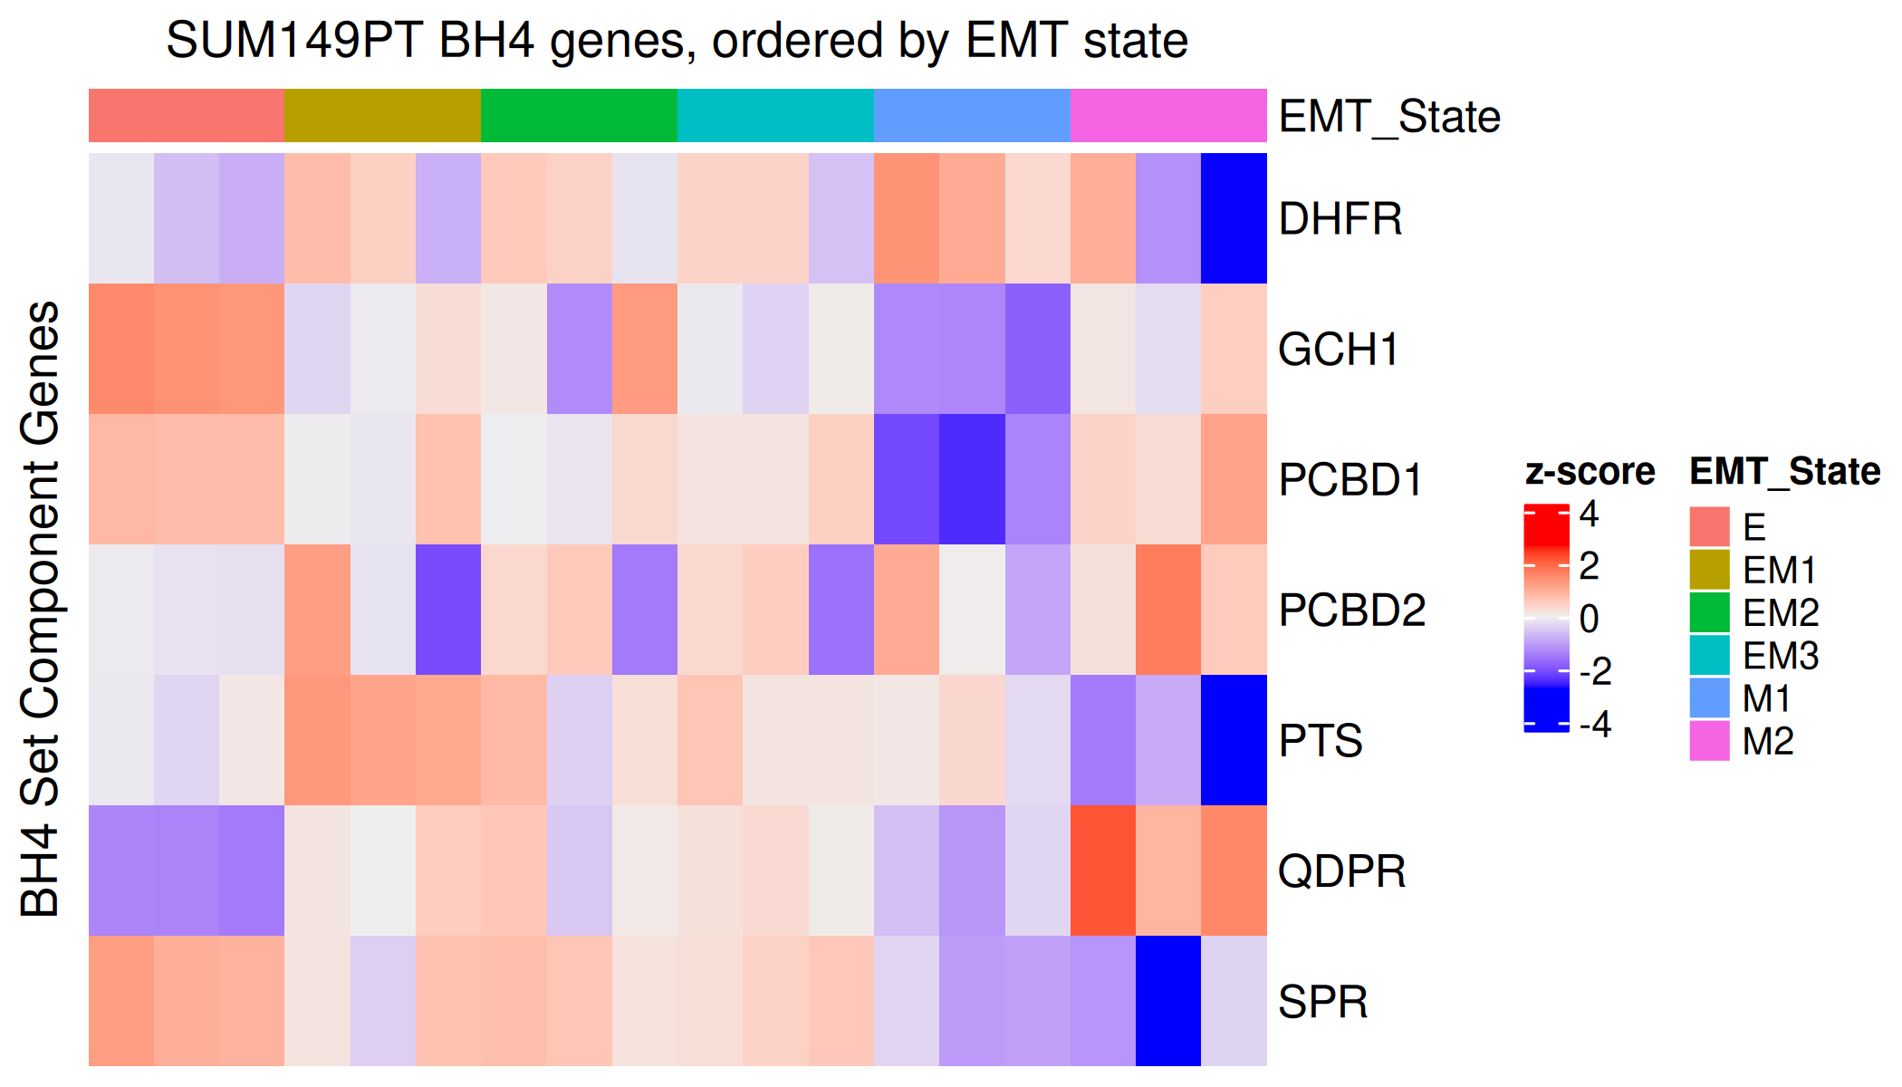
Extended data Fig. 5
a
BRCA scRNA-seq glutathione
b
BRCA scRNA-seq CoQ10
c
BRCA scRNA-seq thioredoxin
d
BRCA scRNA-seq Peroxiredoxin
e
f
SUM159PT BH4 genes

